Slide 1

DCON? What’s That?
Capital District Circle K International
Membership Development & Education Committee
January 2015

Slide 2
The Basics
Who: All members of Circle K International within the Capital District
What: District Convention
Where: Hyatt Fairfax at Fair Lakes in Fairfax, Virginia
When: February 20-22, 2015
Why: To celebrate all the hard work of our district over the past year!
How: Banquets, Dancing, Awards, and a murder mystery…

Slide 3
Murder Mystery?
You read right! This year’s DCON theme is
A Little Service Never Killed Nobody
It's the crime of the century - the twentieth century that is. Take a trip back to the 1920s for this murder mystery event. Gather your Great Gatsby threads & remember that A Little Service Never Killed Nobody.

Slide 4
Highlights
Opening session where costumes are ENCOURAGED =)
Casino Night with fun prizes
Interesting workshops
District Leadership Elections
Great Gatsby dance
Interactions with other CDCKI members and members of the Capital District Kiwanis Family!
Club Awards

Slide 5
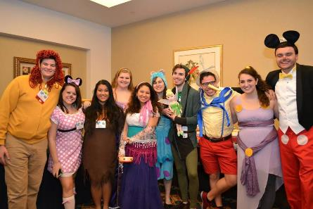
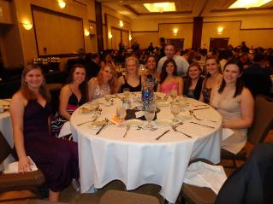
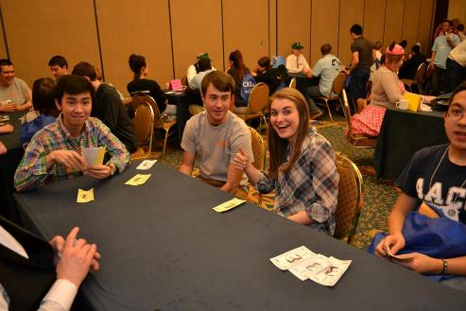
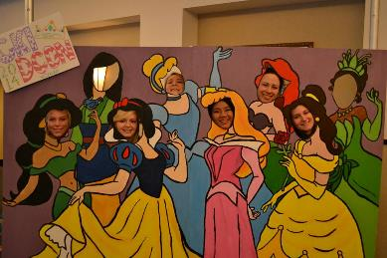
Last Year’s DCON

Slide 6
Want to go?
Register for the event here.
Register before 11:59 pm on January 30th: $170
Register between January 31st and February 12th: $200
Registration includes:
Entrance to all sessions, breakfast and dinner on Saturday and breakfast on Sunday, hotel accommodations (4 to a room), workshops, Casino Night, the Great Gatsby dance, a convention guide, and a convention gift!
Check out more information for the event here.
Check out the Facebook event here.
Contact your Lt. Governor if you have any questions!

Slide 7
Reminders
Club Awards
Applications for club awards can be found here.
All materials for club awards (including any signatures and supplementary materials) must be sent to our District Administrator by January 14th. Check out the applications for more information about where to send everything to.
Running for a District Position
Check out the Candidacy Packet here for more information about running.
All positions are open: Lt. Governors, Editor, District Secretary Treasurer, Governor.
Scholarship
Find information and the application for the 2015 Kiwanis Foundation Scholarship here.

Slide 8

We hope to see you there!

